Slide 1
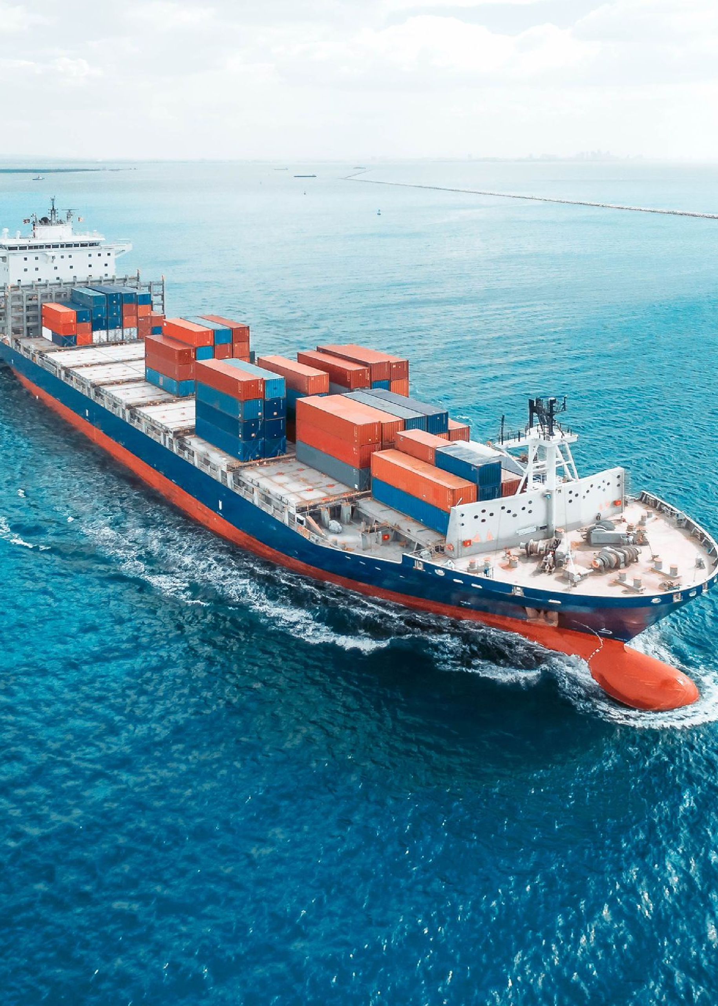


Digital Trade Organization [D.T.O]
Global trade is key to the growth of the world economy. Our innovative private trade union, backed by our proprietary currency, introduces a new era of global trade.
by Jonathan Samuel

Slide 2
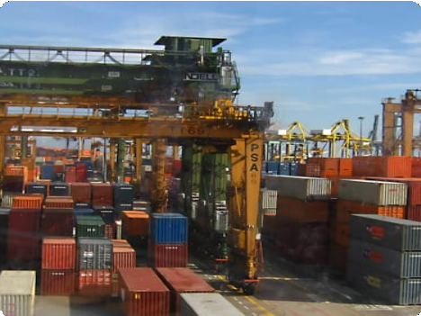

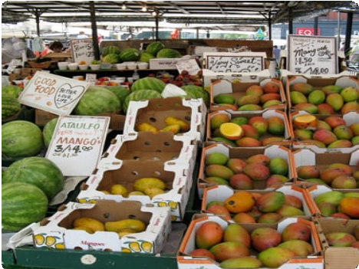
Benefits of Digital Trade Organization
Increased Physical and Digital Economic Growth
Promotes Activity and Cooperation
Greater Product Variety
Digital Trade Organization establishes harmonious economic relationships and fosters mutual gain and asset- sharing. With asset creation per token class and investment across sectors for, with, and of trade.
International trade provides customers with wider and more diverse choices of products and services. It is our responsibility to use technology creating inductive methods with creative outputs and drive the next era of Foreign Direct Investment.
Digital Trade Organization strengthens domestic economies by capitalizing on strengths and diversifying resources through our proprietary consensus algorithm.

Slide 3

Barriers to Global Trade
1 Tariffs and 2
Quotas
Regulations and Standards
3 Political Instability
Restrictions on imported goods and services, which creates a barrier to international market opportunities. With the ability to lobby directly in the market through the DTO we can ensure that a voice will be heard between governments and state operators.
Different standards among countries can hinder the growth of the global market. This is why the DTO will come to fruition in the global economy with its private blockchain standard and consensus algorithm.
What we call aFPC and DTO-541.
Unpredictable factors that can destabilize the markets, such as wars, terrorist incidents, and political changes.
Understanding this the
consensus algorithm is created with four base types. PRO, ZK-Proofs, PoS, aFBA. One for clarity. Two for transactions.
Three for networks. And finally for stakeholder ownership.

Slide 4
International Structures for
Analysis:
1
NAFTA
The North American Free Trade Agreement, focused on promoting trade between the US, Mexico, and Canada.
2
WTO
The World Trade Organization, which establishes rules and resolves disputes for international trade.
3
TPP
The Trans-Pacific Partnership, aimed at reducing tariffs and promoting economic cooperation among nations along the Pacific Rim.
4
World Bank
Waiting for deployments of monies when there can be a globally synergistic route for exchange of all trade routes and monetary infrastructures for countries.
5
International Monetary Fund
Control of Government requests does not enable growth only financial worry
6
Bank of International Settlements
Faster, stronger, and more efficient processing for all monetary needs that countries can rely on for the growth of countries who are member-partners.

Slide 5
Effects of Global Trade on the
Economy
Job Creation
Digital Trade Organization will be a vehicle that drives job creation in industries specializing in exporting goods and services.
Innovation and Competition
Global trade encourages innovation and competition, the Digital Trade Organization will be focused on promoting a continuous cycle of improvement and growth.
Economic Growth
Countries that engage in trade are more likely to see rapid growth and increased prosperity. Digital Trade Organization will promote stability and security away from austerity in the market.
Higher Standard of Living
Trade allows countries to access products and services they may not be able to produce on their own, increasing their standard of living. The Digital Trade Organization keeps this in mind to grow the frameworks of markets by producing new ones on the blockchain for open market investments.

Slide 6

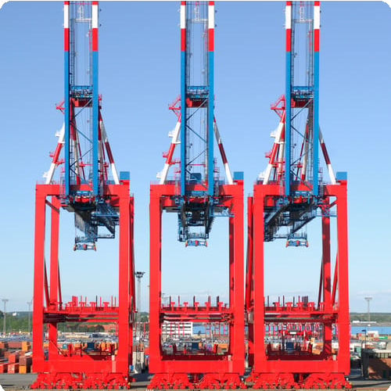

Challenges Facing Global Trade
Political Volatility
Infrastructure Challenges
Intellectual Property Rights
Political endorsements can be unpredictable and can significantly affect international trade. The Digital Trade Organization seeks stewardship to enrichment from our own standing to be amongst and for the standing of others.
Ports, roads, and transportation networks need to keep up with demand and the increasing size of cargo vessels. Through the Digital Trade Organization we can create the investments that will enrich the lives of all dockers and dock workers that add value through their labor and creation.
Resolving disputes surrounding intellectual property rights is essential to maintaining international trading relationships. The Orion Blockchain was designed for this purpose by Mr. Samuel to have everything enforceable and engageable for what a person creates within the Digital Trade Organization.

Slide 7
Emerging Trends in Global Trade
Industry 4.0
Sustainability
Global Partnerships
The rise of smart factories and supply chains, enabled by artificial intelligence, machine learning, and IoT technologies. Further backing the Orion Blockchain that is designed by Mr. Samuel for the creation of a stable and more equitable world.
The increase in sustainable commerce, with firms striving for eco-friendly production and supply chain methods.
With the Socio-Economic Development Index and its Market Charter there will be strict bylaws focused on sustainability engineering and systematic changes from systems out of modalities.
The formation of international partnerships, such as the China Belt and Road Initiative, to support trade growth among participating countries. With our own trade initiatives to invest into all nations and nation-state partners who are member-partners of the Digital Trade Organization.

Slide 8
Role of Technology in Global Trade
E-commerce
E-commerce has made global trade more accessible to small businesses and individual entrepreneurs by eliminating trade barriers such as transportation and physical storage requirements.
1
2
3
Automation
Blockchain
Automation has reduced labor costs and helped to speed up the manufacturing process, making global trade faster and more efficient.
Blockchain technology has enabled transparent and secure trade finance systems, reducing the risks associated with global trade.

